Slide 1
OPTICS Clustering

Slide 2
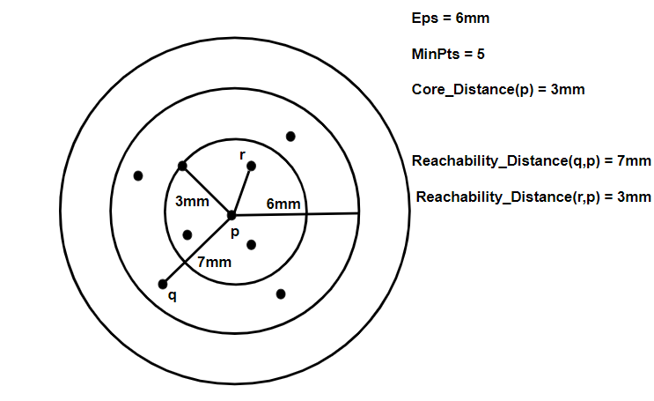
What is OPTICS?
OPTICS stands for Ordering Points To Identify the Clustering Structure.
It’s a density-based clustering algorithm, like DBSCAN.
It’s special because it can find clusters of different densities in the same dataset!

Slide 3
Why Use OPTICS?
Handles clusters with different densities (DBSCAN struggles with this).
No need to pick just one eps value for all points.
Creates a reachability plot that shows how clusters are formed.
Can find nested clusters (clusters inside clusters).

Slide 4
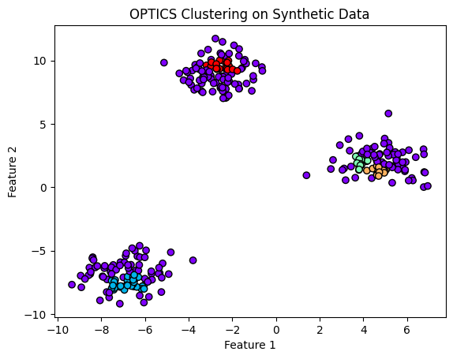
How Does It Work?
Pick a starting point and check if it has enough nearby neighbors (MinPts).
If yes, it’s a core point, and its neighbors are checked too.
Calculate reachability distances for nearby points.
Order all points by reachability distance — makes the reachability plot.
Clusters look like valleys in the plot (low reachability), noise looks like peaks.

Slide 5
Important Ideas
Core Distance: Minimum distance needed to call a point a core point.
Reachability Distance: Shows how hard it is to reach one point from another.
Reachability Plot: A graph showing which points are clustered together.

Slide 6
How Clusters Are Found
Clusters = Valleys: Low reachability distance → points are close → same cluster.
Noise = Peaks: High reachability distance → isolated points → likely noise.
You can “cut” the plot at any point to make DBSCAN-like clusters!

Slide 7
OPTICS vs DBSCAN
🔍 Feature | OPTICS | DBSCAN
Different Densities | ✅ Yes | ❌ No
Reachability Plot | ✅ Yes | ❌ No
Nested Clusters | ✅ Yes | ❌ No
Memory | Uses more | Uses less
Speed | Slower | Faster
Noise | Finds using plot | Finds directly

Slide 8
Advantages
Finds clusters of different shapes & densities.
Makes a reachability plot for flexible cluster cutting.
Detects hierarchical clusters.
Saves time if you’d run DBSCAN multiple times with different eps!

Slide 9
Drawbacks
Slower than DBSCAN because it sorts points.
Uses more memory (keeps a queue).
May need max_eps tuning for huge datasets.
Results are very close to DBSCAN but can differ slightly.

Slide 10
Example in Python
Use OPTICS from scikit-learn.
Example: OPTICS(min_samples=5, xi=0.05).
Get clusters with clustering.labels_.
Can “cut” the reachability plot for different cluster levels!

Slide 11
Related to HDBSCAN
HDBSCAN builds on OPTICS and DBSCAN.
Handles even more complex data with different densities.
HDBSCAN is faster but uses more memory than OPTICS for very large data.

Slide 12
Thankyou

